Slide 1
Foundation Model for Brain Lesion
Segmentation with Mixture of Modality Experts​
Presenter: Xinru Zhang
Supervisor: Wenjia Bai
2024-10-24

Slide 2
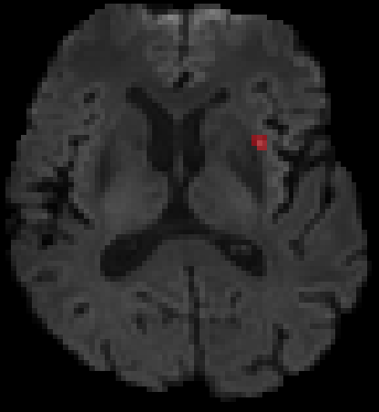
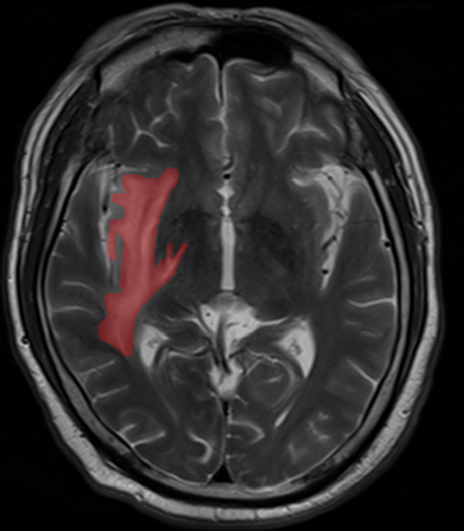
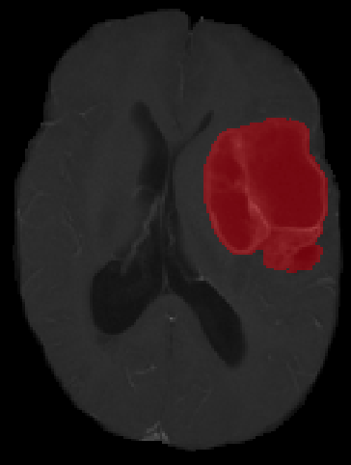
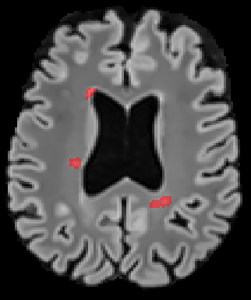
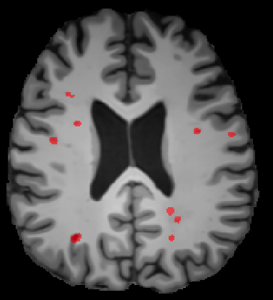
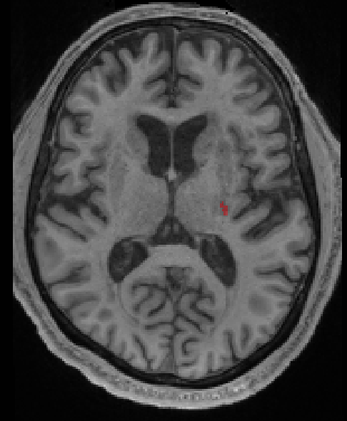
Background
Brain lesion segmentation is pivotal in aiding clinical professionals, particularly in advancing deep learning methodologies. Diverse types of brain lesions exhibit distinct characteristics and may with different modalities, posing a challenge in establishing a foundational model capable of addressing this array of conditions.
Zhang et al., Neuroimage 2023; Ostrom et al., Neuro-oncology 2019; Reber et al., PNAS 2021; Bonkhoff et al., Nature communications 2021

Slide 3
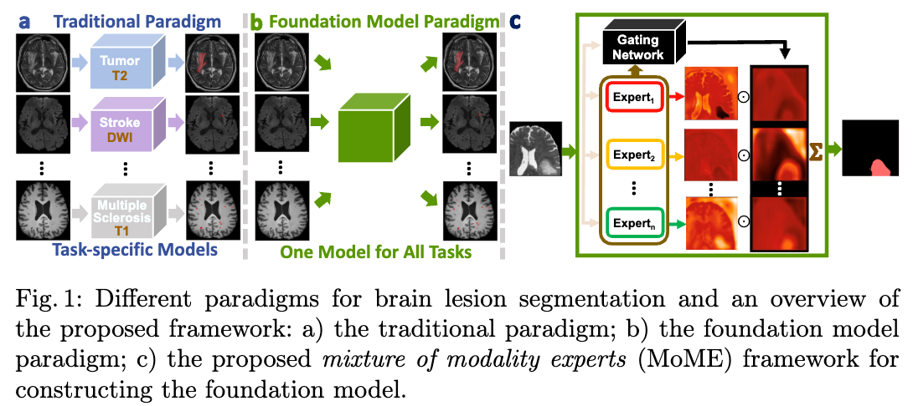
Motivation

Slide 4
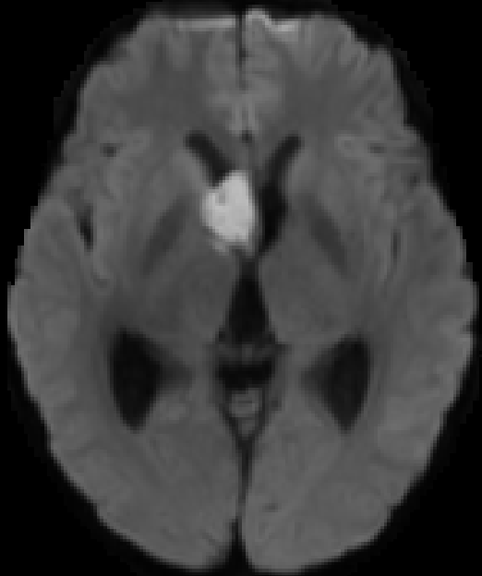
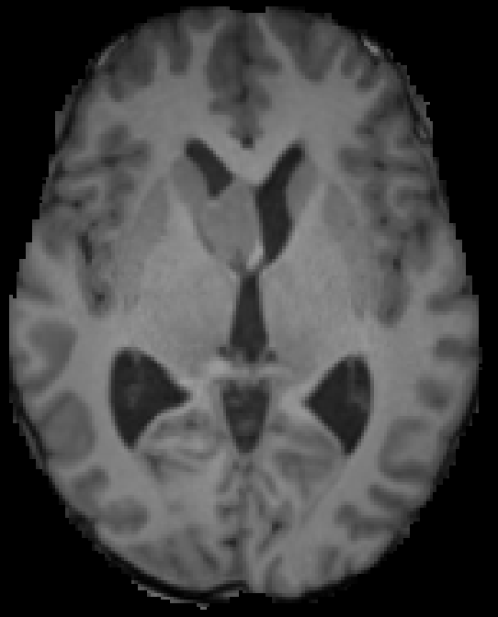
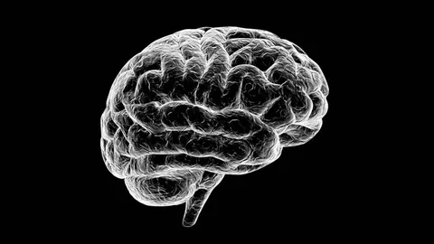
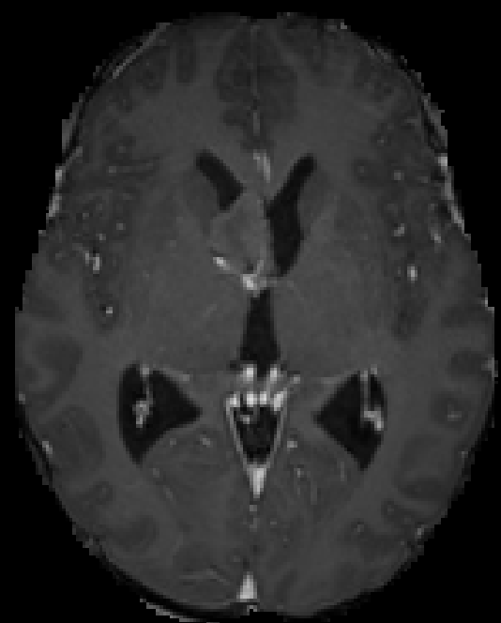
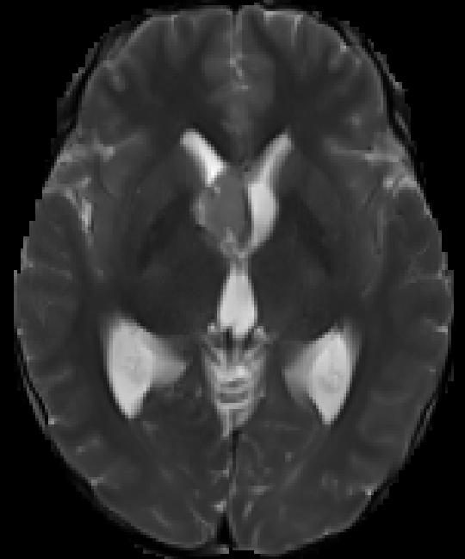
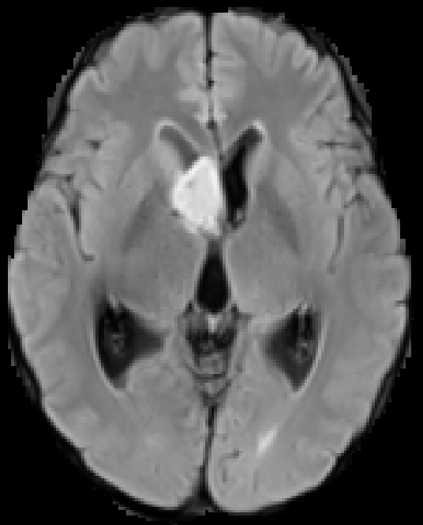
Modality-based Experts
All MRI modalities are scanned from the same brain, inherently possesses an internal relationship.
Given$N \text{imaging} \text{modalities}{ \left\{ℳ_{i}\right\}}_{i=1}^{N}$ of interest, $ℳ_{i}$ represents the $i^{th}$ modality, $N$ expert networks ${\left\{E_{i}\right\}}_{i=1}^{N}$are developed, $E_{i}$ is the $i^{th}$ expert. Gating network is marked as $G$.

Slide 5


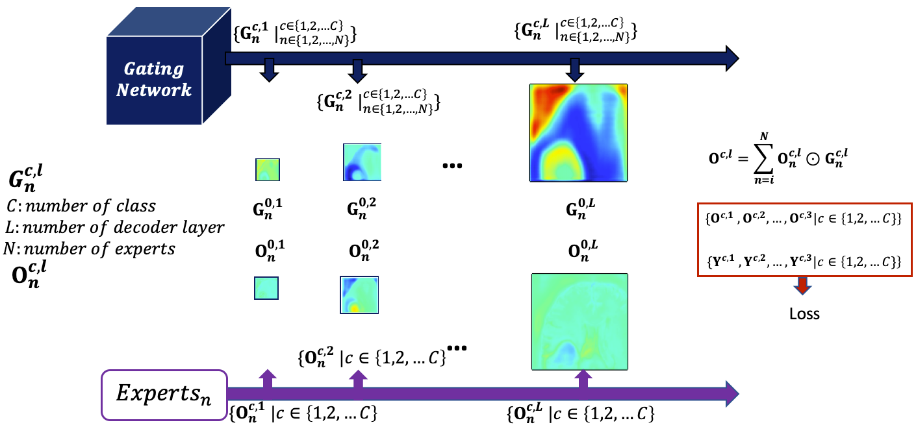
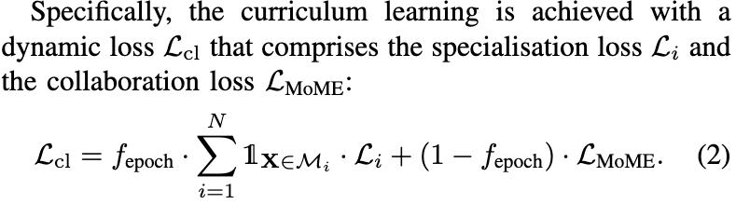
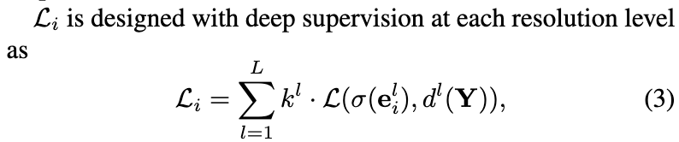
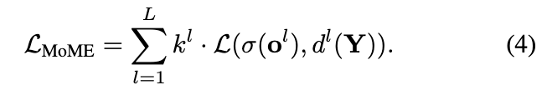
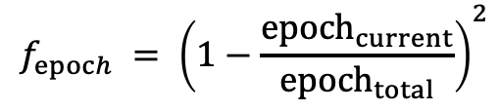
Hierarchical Gating Network to foster Collabration
Curriculum Learning to alleviate degeneration
Promote collaboration among experts while also preserving each expert's specialisation
Hierarchical Gating Network
Curriculum Learning
$$f_{epoch} = {\left(1−\frac{epoch_{current}}{epoch_{total}}\right)}^{2}$$
MRI modalities exhibit inherent relationships. We leverage this by employing a hierarchical gating network to foster collaboration. Deep supervision is applied to both the gating network and experts, ensuring layer-by-layer supervision, enhancing collaboration.
Regarding the training of MoME, an anti-degeneration strategy based on curriculum learning is developed, where model training gradually transitions from specialising the role of each expert to determining the entire model through collaboration.
Notes:
1. MRI modalities exhibit inherent relationships. We leverage this by employing a hierarchical gating network to foster collaboration. Deep supervision is applied to both the gating network and experts, ensuring layer-by-layer supervision, enhancing collaboration.
2. Regarding the training of MoME, an anti-degeneration strategy based on curriculum learning is developed, where model training gradually transitions from specialising the role of each expert to determining the entire model through collaboration.

Slide 6
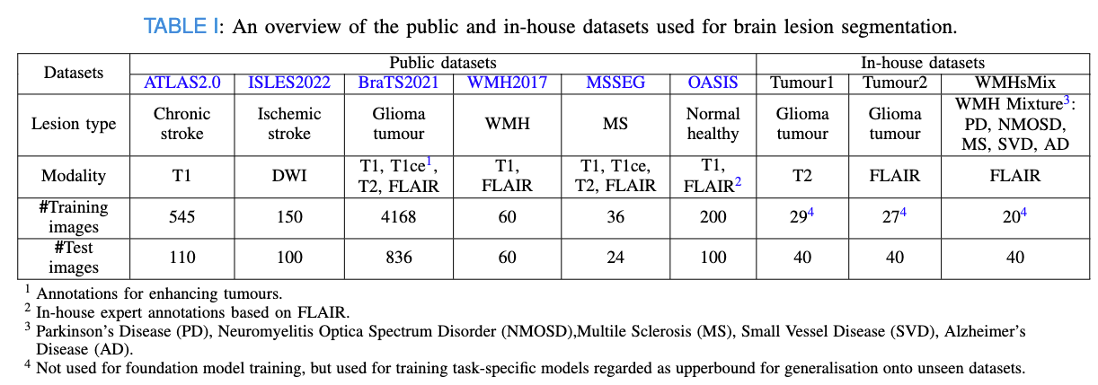
Datasets
We conducted comphrehensive experiments on nine brain imaging datasets comprising a total number of 6,585 annotated 3D images, with five MRI modalities and eight lesion types.

Slide 7
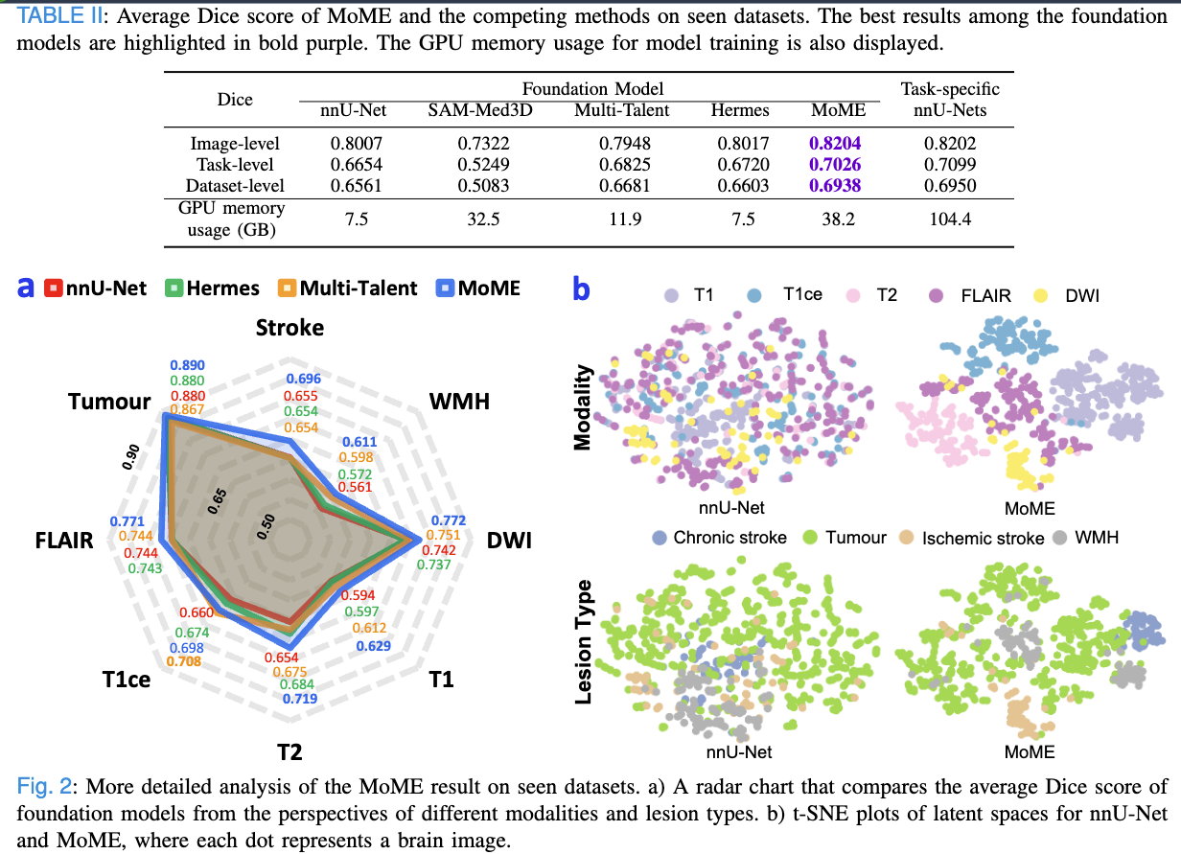
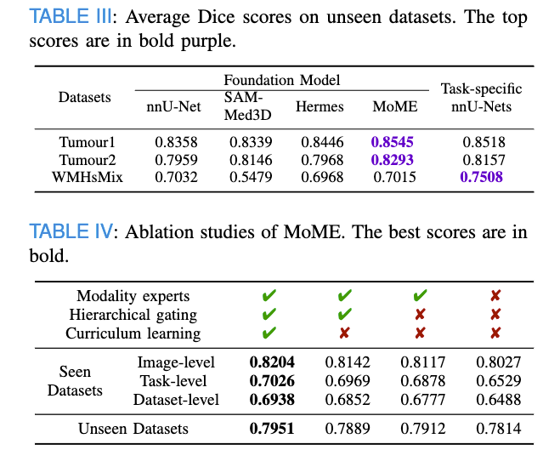
Quantitative Experimental Results

Slide 8
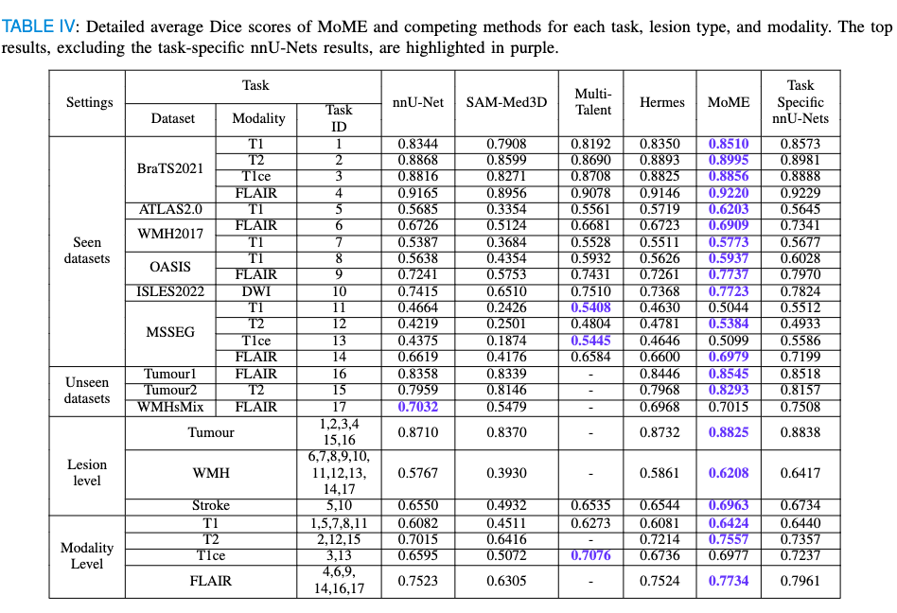
Detailed Results for Each Task

Slide 9
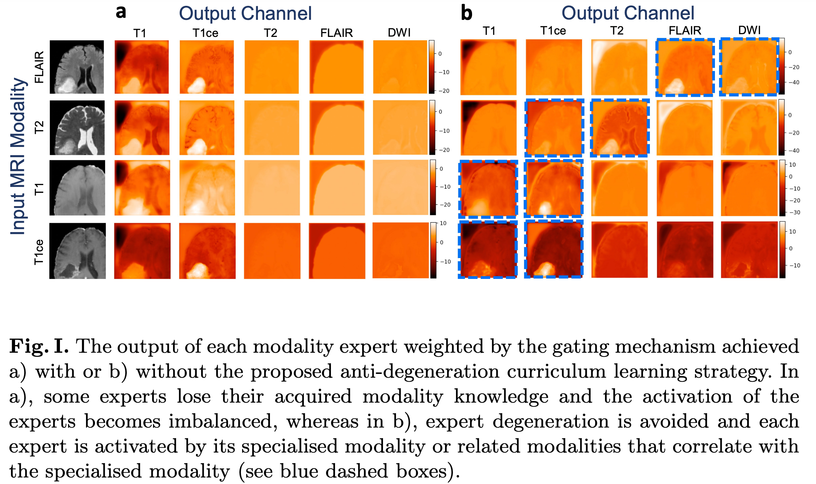
Interpretability

Slide 10

Q & A
Project Github Link: https://github.com/ZhangxinruBIT/MoME
Paper Link: https://arxiv.org/pdf/2405.10246

Slide 11
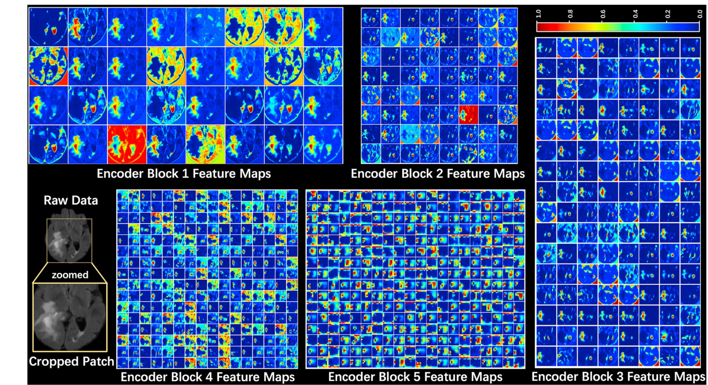
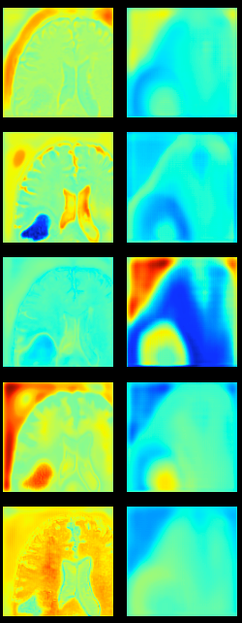
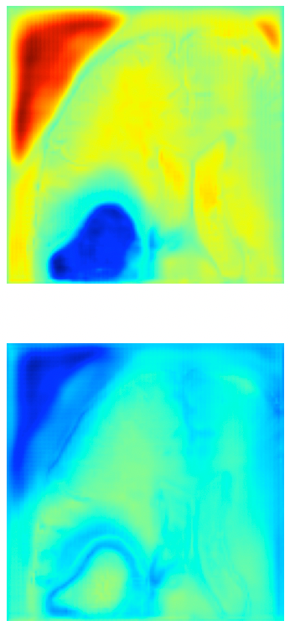
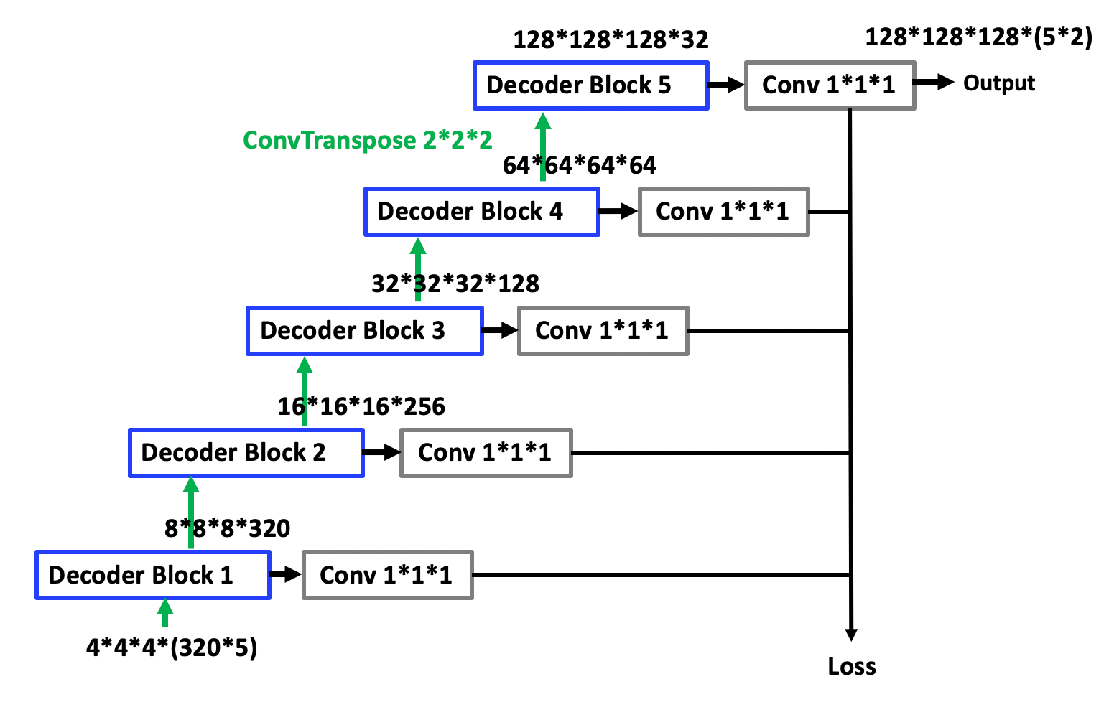
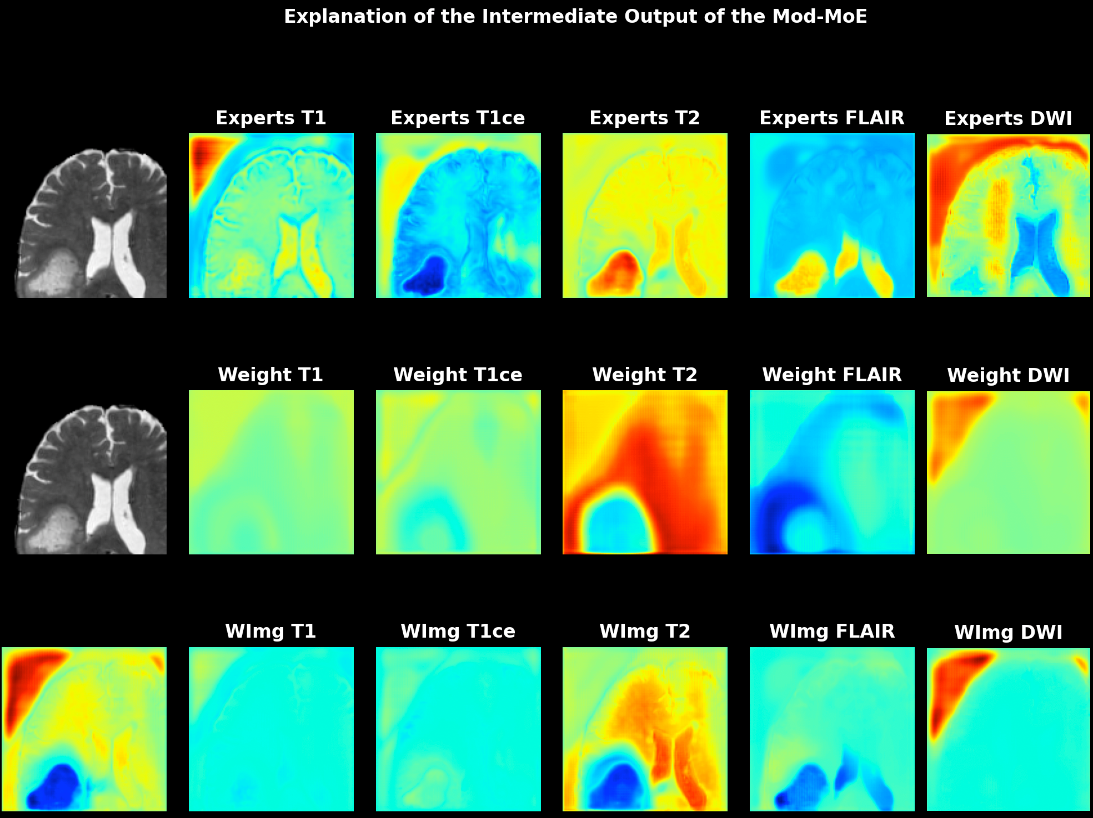
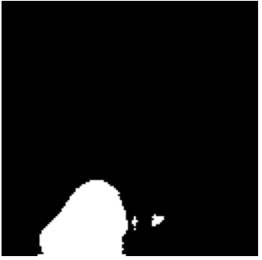

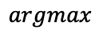
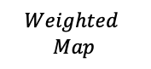
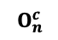
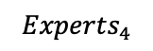
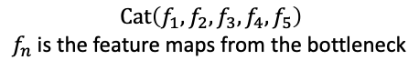
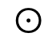
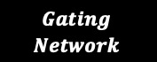
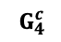
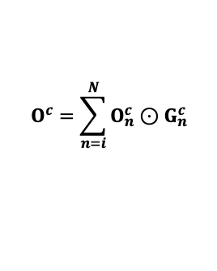
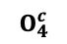
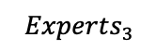
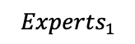
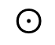
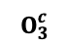
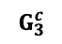
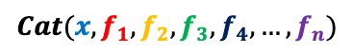
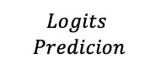
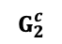
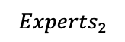
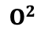
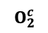





Method: Architecture
What is the input of the Gating Network, and what is the structure of the Gating Network?
$$Cat(x,f_{1},f_{2},f_{3},f_{4},…,f_{n})$$
$$Gating$$
$$Network$$
$$Cat\left(f_{1},f_{2},f_{3},f_{4},f_{5}\right)$$
$f_{n}$is the feature maps from the bottleneck
$$O_{1}^{c}$$
$$G_{1}^{c}$$
$$O^{c}=\sum_{n=i}^{N}{O_{n}^{c}⊙G_{n}^{c}}$$
$$Experts_{1}$$
$$⊙$$
$$O_{2}^{c}$$
$$G_{2}^{c}$$
$$Experts_{2}$$
Bottleneck Feature Maps
$$⊙$$
$$O^{1}$$
$$O_{3}^{c}$$
$$G_{3}^{c}$$
$$Experts_{3}$$
$$⊙$$
$$O_{4}^{c}$$
$$G_{4}^{c}$$
$$O^{2}$$
$$Experts_{4}$$
$$⊙$$
…
$$O_{n}^{c}$$
$$G_{n}^{c}$$
$$Experts_{n}$$
$$⊙$$
$$argmax$$
$$Logits$$
$$Predicion$$
$$Weighted$$
$$Map$$

Slide 12


Method: Architecture
What is the input of the Gating Network, and what is the structure of the Gating Network?
$$Cat(x,f_{1},f_{2},f_{3},f_{4},…,f_{n})$$
$$Gating$$
$$Network$$
$$Cat\left(x,f_{1},f_{2},f_{3},f_{4},f_{5}\right)$$
$f_{n}$is the feature maps from the 1st layer of encoder, $x$ is the raw intensity image
$$O_{1}^{c}$$
$$G_{1}^{c}$$
$$O^{c}=\sum_{n=i}^{N}{O_{n}^{c}⊙G_{n}^{c}}$$
$$Experts_{1}$$
$$⊙$$
$$O_{2}^{c}$$
$$G_{2}^{c}$$
$$Experts_{2}$$
$$⊙$$
$$O^{1}$$
$$O_{3}^{c}$$
$$G_{3}^{c}$$
$$Experts_{3}$$
$$⊙$$
$$O_{4}^{c}$$
$$G_{4}^{c}$$
$$O^{2}$$
$$Experts_{4}$$
$$⊙$$
…
$$O_{n}^{c}$$
$$G_{n}^{c}$$
$$Experts_{n}$$
$$⊙$$
$$argmax$$
$$Logits$$
$$Predicion$$
$$Weighted$$
$$Map$$

Slide 13



Method
Training Approaches:
Simultaneously train the gating network and the experts, allowing the network to autonomously determine what each expert should learn. (Explanation may be lacking)
Train each expert with a manually defined function in the first step, fix the pretrained experts, and train the gating network in the second step.
Initiate training for each expert with a manually defined function in the first step to establish a solid starting point. Subsequently, fine-tune the experts and train the gating network together in the second stage.
Baseline Architecture:
All MRI modalities are scanned from the same brain, inherently possesses an internal relationship.
For 2&3, in the 1st step, we design the modality-based experts:
Training the experts based on modality offers a straightforward classification approach, especially given that each modality originates from the same real brain. This implies the possibility of a higher-dimensional image representation, allowing the association of each modality with its internal relationships.

Slide 14

4. Neuralizer: General Neuroimage Analysis without Re-Training(2023)

Slide 15




Background: related work
SAM-based methods: SAM-MED3D
(2023)
2. Context Prior Learning: Hermes
(2024)
Task Prior
Not feasible
Piont-based prompt
Not feasible
3. Multi-dataset learning-based methods: Multi-Talent
(2023)
Genelize to unseen dataset
Not feasible

